Slide 1

FIFA World Cup 2022 Simulation
By - Rajat Kumar
Contact – rajat3@illinois.edu
https://github.com/rajat3Illinois/2021_Spring_finals

Slide 2
Tables of Content
Guess the Players (Fun Activity)
Introduction
Purpose of the Project
What is Monte Carlo Simulation ?
Thought Process
Data Sets Sources
Keen Observations and Design Process
Results so far
Improvisation and Future Scope
References
Questions / Suggestions

Slide 3



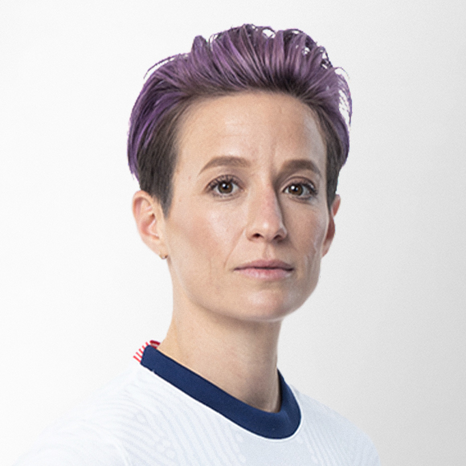
Guess the Players ??? (Fun Activity)
Megan Rapinoe
Lionel Messi
Christian Pulisic

Slide 4
Introduction
The FIFA World Cup is the most widely viewed and followed sporting event in the world.
32 teams qualify for the tournament with the host nation given an automatic qualification.
The qualified team comes from six confederations (continents):
CAF (Africa)
AFC (Asia)
CONENBOL (South America)
CONCACAF (North America)
Oceania
UEFA (Europe)
Tournament Format is as follow :-
Group Stages (32 teams split into 8 groups)
Last -16 Stage (Top 2 teams from each group qualify)
Quarter-Final
Semi-Final
Final

Slide 5
Project Purpose
With this Project, I aim to simulate the FIFA World Cup 2022 using Monte Carlo Simulation and provide statistical analysis on the defined hypothesis.
The hypothesis which we are trying to corroborate are mentioned below : -
The curse of defending champion (France) bowing out from the Group Stage and / or not even making the world cup is highly unlikely.
It is highly likely that the host nation would qualify for the knockout stages.

Slide 6
What is Monte Carlo Simulation ?
Mathematical Technique that generates random variable for modeling uncertainty of a certain system.
Use to handle uncertain parameters using probabilistic approach.
Provides probabilistic estimate of the uncertainty in a model.
Helps to see possible outcomes of a decision.
Effective in complex systems including food science and healthcare.

Slide 7
Thought Process
We will first compute the teams that are likely to qualify for the World Cup.
The qualification of the team is based on the following factors:-
Current ranking (normalized for each confederation while calculation)
Attacking prowess (Using Avg Attacking Players Rating)
Defensive prowess (Using Avg Defensive Players Rating)
Goalkeeper prowess (Using Avg Goalkeeper Players Rating)
Median player rating.
Total market value of the Players in the team.
Number of teams that can qualify from each consideration.
All teams qualified (with host nation Qatar given direct entry), then are split into the 8 groups.
The groups of each team is based on Pots Seeding as explained in upcoming slides.

Slide 8
Data Sets Sources
Fifa 20 Players: https://www.kaggle.com/stefanoleone992/fifa-20-complete-player-dataset
Latest FIFA Ranking: https://www.fifa.com/fifa-world-ranking/ranking-table/men/
https://www.transfermarkt.us/statistik/weltrangliste
Various Confederation data, constructed through Wikipedia.
UEFA.csv
Asia.csv
AFC.csv
NorthAmerica.csv
SouthAmerica.csv
Oceania.csv

Slide 9
Overview
There are in total 32 teams qualify for the tournament with the host nation given an automatic qualification. These 32 teams are decided based on confederations (continents) mentioned below: -
CAF (Africa) AFC (Asia) CONENBOL (South America) CONCACAF (North America) Oceania UEFA (Europe)
Only limited number of teams can qualify from a particular confederation. In other words, the number of teams from a particular confederation is pre-defined as follows: - {'CAF': 4, 'AFC': 4, 'UEFA': 13, 'CONMEBOL': 5, 'CONCACAF': 4, 'OFC': 1}
As per the rules the Tournament Format is as follow: - Group Stages (32 teams split into 8 groups) Last -16 Stage (Top 2 teams from each group qualify) Quarter-Final Semi-Final Final

Slide 10
Strengths of the Approach
POT SEEDING UNDERSTANDING
Toss factor would be crucial in deciding the outcome of the match.
Team Past wins and losses plays a role in the determination of team result.
Object Oriented Programming Technique.
Use of Poseidon Approach to calculate the match result is effective.
Host nation factor.

Slide 11
Important Assumptions
Host nation is likely to perform 25% better as per their normal performance.
There is at least 1 team from each confederation (continent).
Squad size (Bench Strength) are crucial in determining the qualification of team.
The number of players above the median rating plays an important role in qualification.
The total market value combined of all the players of a team has an impact on teams qualification.
For certain teams as well as host nation (Qatar), attacking prowess and defensive prowess are randomly added based on their ranking.
The Ranking points of the team along with the attacking and defensive prowess are important in deciding the match result between two teams.

Slide 12
Design Process and Key Observation
Key Observations: -
Keen observation and pre-processing is crucial on the players_20 dataset containing the details of rating, market value, team position and nationality.
During the design process, it was noticed that there is a mismatch in the nation names as per the Team Ranking dataset and dataset.
For handling the above scenarios, proper pre-processing of data is undertaken.
For some team(s) the defensive and attacking power are randomly assigned between a range based on their rank. With teams having ranks between 20 to 30 having power assigned randomly from 65 to 67, with team having rank between 31 to 50 assigned 63 to 65 and so forth.
Goalkeeping power is considered while calculating the he defensive power.
Design Process: -
Keeping in mind all the above key observations and the relevant dataset, Panda’s data frame is predominantly used.
Since it involves the team data stats, an OOP design defining the Team objects is developed, providing the necessary feasibility to output the results after every simulation.

Slide 13
Understanding Pot Seedings
The teams in groups is dependent on Pots Seeding.
The 4 pots similar to the one below predominantly defines the groups of each team. The host nation Qatar automatically is put to the Pot1.
Teams in the pots are officially decided as per their ranking.
Once the pots are filled as per qualified team ranking, the 8 groups are randomly constructed, with each group containing one team from every Pot.
Pot 1 | Pot 2 | Pot 3 | Pot 4
Qatar (Host)

Slide 14
Results so far (In process):-
Based on the design process and the data set.
Qualified Team Pots;
Pot 1 | Pot 2 | Pot 3 | Pot 4
Qatar | Mexico | Poland | Morocco
Uruguay | Italy | Senegal | South Korea
Spain | Croatia | Sweden | Costa Rica
Argentina | Denmark | United States | Ghana
Portugal | Germany | Japan | Ivory Coast
England | Netherlands | Iran | Saudi Arabia
France | Columbia | Serbia | Canada
Brazil | Chile | Turkey | New Zealand

Slide 15
Results so far (contd.):-
Based on the previous pots, one of possible Groups of team could be as follows:-
Group A | Group B | Group C | Group D | Group E | Group F | Group G | Group H
Brazil | France | Spain | England | Qatar | Uruguay | Argentina | Portugal
Mexico | Denmark | Germany | Italy | Croatia | Chile | Columbia | Netherlands
Serbia | Japan | Turkey | Sweden | Senegal | United States | Poland | Iran
Costa Rica | Canada | New Zealand | South Korea | Morocco | Ghana | Saudi Arabia | Ivory Coast

Slide 16
Results so far (contd.)
Results after carrying out simulations are accounted:-
For 50 Simulations: -
Percentage of France reaching World cup is 84 % .
Chances of France reaching the knockout stage of World Cup is 64.28 %.
Chances of Qatar reaching the knockout stage of World Cup is 34 %.
For 100 Simulations: -
Percentage of France reaching World cup is 78 %.
Chances of France reaching the knockout stage of World Cup is 61.53 %.
Chances of Qatar reaching the knockout stage of World Cup is 41 %.
For 200 Simulations: -
Percentage of France reaching World cup is 79.5 %.
Chances of France reaching the knockout stage of World Cup is 58.49 %.
Chances of Qatar reaching the knockout stage of World Cup is 38 %.
For 500 Simulations: -
Percentage of France reaching World cup is 82.6 %.
Chances of France reaching the knockout stage of World Cup is 61.74 %.
Chances of Qatar reaching the knockout stage of World Cup is 36.4 %.

Slide 17
Improvisation and Future Scope
Furthermore, this world cup is taking place in December than the usual June – August period, leading to uncertainty about team performance.
It can be inferred that pot seedings can play a major role in determining the qualification from group stage. Agree or Disagree ? Thoughts ?

Slide 18
References
https://www.espn.com/soccer/fifa-world-cup/story/3860182/2022-world-cup-how-qualifying-works-around-the-world
https://towardsdatascience.com/simulating-the-fifa-world-cup-2022-d363fad7da22
https://core.ac.uk/download/pdf/216466812.pdf
https://en.wikipedia.org/wiki/2018_FIFA_World_Cup_seeding

